Slide 1
Workplace Etiquette
Best Tips for IN-and-Out of the Office
Dana, Justin, Jonathan

Slide 2
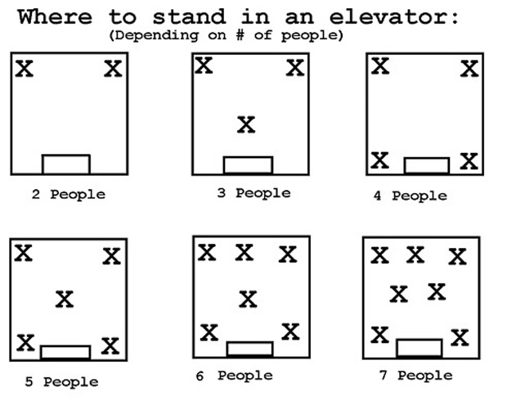
Elevator Talk:
Unplugged & Personal
  Cell phone & headphones stowed away
  Make a pointless comment to lighten the mood
  Refrain from speaking of the meeting you came from until OUT of the building or in personal office
  Hold the door if someone is trying to catch it

Slide 3
Tricky Emails
DO
Don’t
Subject Line Attention Getter
Professional addressing and salutation
Be conversational, but specific
Proofread and select recipient LAST
Follow-Up in 24 hours
Include information not for everyone’s eyes
  Forwarding happens without you knowing!
Email’s are not novels
Forget to check spelling and grammar-reflects a poor image
Notes:
Short and concise emails. Do not use humor that can be taken in different tone, and or people of different culture . Get to the point and always be sure not to have information in an email that you would want anyone else to see that you said. Forwarding happens all the time and there is no talking your way out of it. Your email is flat on it.

Slide 4
Work Station Must’s
Professional Workspace
Respect of Others Workspace
Neat and Clean
Appropriate personal touches
Food consumption should be limited
  Smell and noise can be distracting
Knock of cubicles and introduce you are there
Don’t barge in
Call/email if you need to stop by coworkers desk at specific time

Slide 5
Cell Phone Usage
2 options- Silent or vibrate setting
Phones put away!
  Only have phones in meetings if it’s a must
If you have to make a phone call, go to a private quiet place (talk in low voice)
If expecting important call/text let the boss and coworkers know
Let phone calls go to voicemail
  Respond with a text message rather then a phone call back

Slide 6
It’s Not Just A Job
Business Dinner/Lunch
  Host always pays
  Don’t eat food fast
  Put napkin on your lap before you eat
  Always use the silverware when eating
  Never get a to go box
  Handshakes before and after the meal
  Always thank the host for paying for the meal
Interact with the older co-workers.
They are just as quick to judge you as you judge them
SPEAK UP
  Prove that you can do the tasks that need to be done
They assume you are a social media fanatic-do NOT be on your phone all the time

Slide 7
These Things Matter?
Interview Prep
Attitude at the Workplace
Confidence
Knowledge of the company
What the company does
Have specific goals
5 year plan
Complaining is off limits
  Never complain about your team
  Don’t be first one to complain
  Wait until lunch or after work
  Limit to one topic
Confidence
Have positive attitude
Positivity leads to productivity

Slide 8
Experienced Professional Feedback
Importance of appearance and body language in an interview/meeting setting?
  “You are trying to sell your talents to your prospective employer, so act the part.”
Free Time talk should include or not include what things?
  “No gossip, politics, money, etc. Do talk about family, vacation, hobbies. Things of that sort.”
How often are you in contact with clients over the phone compared to
emails?
  “Tangible things that you can touch and feel are still a good thing!”
Pet Peeves?
  “Original emails that turn into chain letters that eventually turn into something completely different from the original subject line.”
Notes:
This is real advice and tips from an actual HR interviewer in a hospital and sales manager. Talk to those who have been in similar situations that you may encounter so you can have an idea of how to be prepared.

